Slide 1
Review on Detection and Analysis of Human Disease by Analyzing Tongue Characteristics by Using Deep Learning Department Of Electronics and Telecommunication Government Engineering College, Raipur 492015, (C.G.), India
Mansi Diwan, Omkar Nishad, Priyanshu Soni, Purva Baghel
mansidiwan09@gmail.com omkarnishad752@gmail.com priyanshu72748@gmail.com baghelpurva30@gmail.com
G.E.C RAIPUR (C.G) G.E.C RAIPUR(C.G) G.E.C RAIPUR(C.G) G.E.C RAIPUR(C.G)

Slide 2
OBJECTIVE
Traditional medicine practices, like tongue diagnosis, offer unique insights into health. However, these methods involve subjective judgment and are therefore susceptible to human error .Although its solution has been proposed and tested as tongue image analysis, the methods used to achieve it , has there complication & drawbacks .Our proposal to rectify them is use of Few Shot Learning method for image analysis.

Slide 3
TONGUE DIAGNOSIS IN DIFFERENT MEDICAL PRACTICES
Western Medicine/allopathy regards 'Tongue diagnosis' as an effective noninvasive technique to evaluate the condition of a patient's internal organ in oriental medicine. The main features used in tongue diagnosis are color and coating.
In Ayurveda, 'Jivha-Pariksa' (tongue diagnosis) is the science of reading the tongue, which is always revealing information about the gastrointestinal organs, as well as many other functions and systems of the body.
Traditional Chinese medicine (TCM) is an alternative medical practice . According to TCM different portions of tongue reveal the health information of the corresponding internal organs of a human body.
Notes:
According to the ancient medical science, our tongue is a powerful and primary diagnostic tool. That’s because, when digestion is working well, it influences every aspect of our health as tongue is the beginning of the digestive tract.
In Ayurveda and Traditional Chinese medicine, tongue diagnosis plays an important role but western medicine overlooks it. A modern technology will help to keep the useful ancient practices alive which are neglected by the youth.

Slide 4
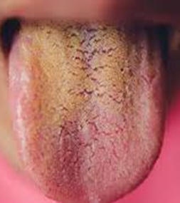
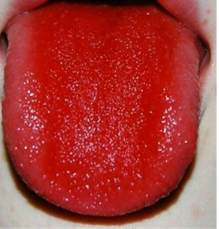
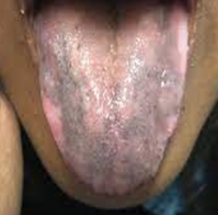
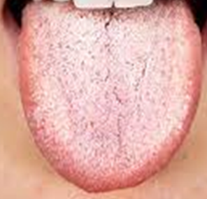
EVALUATION ON TONGUE COLOR
BLACK TONGUE
WHITE TONGUE
YELLOW TONGUE
RED TONGUE
• Folic acid deficiency
• Vitamin B-12 deficiency
Scarlett fever
Adrenocortical insufficiency
Tobacco Use
Side effect of Chemotherapy
Fungal infection
Leucoplakia
Lichen planus
Leucoplakia
Jaundice
Bacterial growth

Slide 5
PROBLEM WITH TRADITIONAL METHOD
Human Error: Many factors can affect the diagnosis and human error is inevitable so machine can reduce the chances of error.
Lack of Knowledge: Nowadays, few people know about the practice of tongue diagnosis. Modernization of it will help people to easily access it.
Besides that, the examination outcome in traditional tongue diagnosis could not be described scientifically and quantitatively.

Slide 6
Image Processing & Classification
Disease detection require image of tongue to be processed and classified based on color & shape.
CNN: Convolution Neural Network is a go-to deep learning algorithm when dealing with image analysis in field of medicine.
Improving from the traditional method CNN/FSL Automatically learn features, potentially uncovering more nuanced patterns and reducing human bias.
CNNs excel at automatically learning hierarchical representations of features from images. In the case of tongue image analysis, the CNN extracts color and shape features from the input tongue images to make disease diagnoses.

Slide 7
CNN (Convolutional Neural Network)
Convolutional Neural Network (CNN) is the extended version of Artificial Neural Networks (ANN) which is predominantly used to extract the feature from the grid-like matrix dataset.
CNN architecture is inspired by the connectivity patterns of the human brain in particular, the visual cortex.
The process starts by sliding a filter designed to detect certain features over the input image, a process known as the convolution operation. Initial filters detect basic features, such as lines or simple textures. Subsequent layers' filters combine the basic features identified earlier on to recognize more complex patterns.

Slide 8
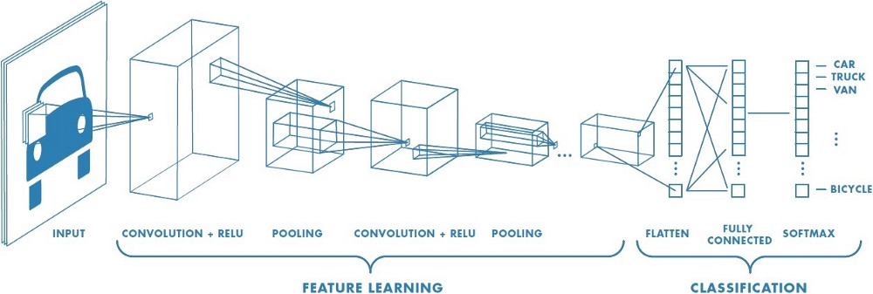
CNN Architecture
The CNN has a hierarchical structure:
A CNN consists of :
Input layer
Hidden layer
Convolution layer
Pooling Layer
Fully connected dense layer
Output layer
Notes:
The input layer of a CNN takes in the raw image data as input. The images are typically represented as matrices of pixel values. The dimensions of the input layer correspond to the size of the input images (e.g., height, width, and color channels).
Convolutional layers are responsible for feature extraction. They consist of filters (kernels) that are convolved with the input images to capture relevant patterns and features. These layers learn to detect edges, textures, shapes, and other important visual elements.
Pooling layers reduce the spatial dimensions of the feature maps produced by the convolutional layers. They perform downsampling operations (e.g., max pooling) to retain the most salient information while discarding unnecessary details. This helps in achieving translation invariance and reducing computational complexity.
Fully Connected Layers :The output of the last pooling layer is flattened and connected to one or more fully connected layers. These layers function as traditional neural network layers and classify the extracted features. The fully connected layers learn complex relationships between features and output class probabilities or predictions.
Output Layer
The output layer represents the final layer of the CNN. It consists of neurons equal to the number of distinct classes in the classification task. The output layer provides each class’s classification probabilities or predictions, indicating the likelihood of the input image belonging to a particular class

Slide 9
Previously used model and their drawback:
CNN Model which have been used previously had their downsides
CaffeNet has Limited depth ,computationally expensive.
ResNet-50 for color extraction. However, this method is suffering with the high computational complexity.
ResNet-18 & ResNet-34 models: This method utilizes the automatic weight updating properties, which resulted in the better performance but taking much time for training.
CheXNet, a CNN with 121 layers, high complexity and require larger data set.

Slide 10
FEW SHOT LEARNING (FSL) MODEL
Few-shot learning (FSL), also referred to as low-shot learning (LSL) in few sources, is a type of machine learning method where the training dataset contains limited information.
Few-shot learning is a process where a model can independently acquire knowledge and improve its performance with minimal examples.
Few-shot learning focuses on enhancing the model’s capability to learn quickly and efficiently from new and unseen data.
In computer vision, we can apply few-shot learning to image classification tasks wherein our goal is to classify images into different categories.

Slide 11
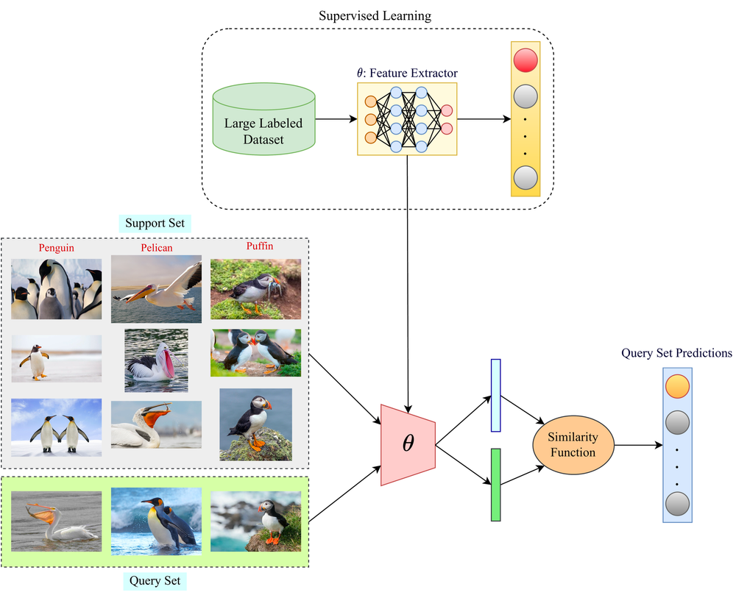
BLOCK DIAGRAM REPRESENTATION OF FEW SHOT LEARNING

Slide 12
ADVANTAGES OF FSL OVER TRADITIONAL MACHINE LEARNING/CNN
Traditional machine learning algorithms are typically designed to perform well on specific tasks and are trained on huge data sets with a large number of labeled examples.
One challenge of traditional machine learning is the fact that training models require large amounts of training data with labeled training samples.
Low requirement of data set in FSL give us advantage of diagnosing rare diseases ,for which a lot of data may not be available.

Slide 13
CONCLUSION
There have been several methods to study the tongue classification on the basis of colour, but still the research area is lacking in various ways. In this paper a new approach for the colour detection of tongue using Few Shot Learning has been proposed. Traditionally CNN is being used but it can be replaced by FSL as it requires less data set as compared to CNN. FSL can give satisfactory results even with low number of dataset. The complete process has been described in the paper.

Slide 14
REFERENCES
[1] Improvement in tongue colour image analysis for disease identification using deep learning-based depth wise separable convolution model by S. Rajakumaran Research scholar, Dept. of Computer Science and Engineering., Annamalai University and Dr. J. Sasikala Dept. of Information Technology, Annamalai university. e-ISSN : 0976-5166
[2] Machine Learning for Tongue Diagnosis by Siu Cheung Hui, Yulan He, Doan Thi Cam Thach; School of Computer Engineering, Nanyang Technological University, Singapore.1-4244-0983-7/07/2007 IEEE
[3] Classification of Tongue Colour Based on CNN by Jun Hou, Hong-Yi Su, Bo Yan, Hong Zheng, Zhao-Liang Sun, Xiao-Cong Cai; Key Lab of Intelligent Information Technology; Beijing Institute of Technology. 978-1-5090-3619- 6/17/2017
[4] Constitution Identification of Tongue Image Based on CNN by Hao Zhou, Guangqin Hu, Xinfeng Zhang; Beijing University of Technology. 978-1-5386- 7604-2/18/2018 IEEE
[5] Intelligent Deep Learning Based Disease Diagnosis Using Biomedical Tongue Images by V. Thanikachalam1, S. Shanthi, K. Kalirajan, Sayed Abdel-Khalek4,5, Mohamed Omri and Lotfi M. Ladhar. DOI:10.302604/cmc.2022.020965
[6] S. Ravi and H. Larochelle, “Optimization as a model for few-shot learning” 2016.

Slide 15
THANK YOU

